Slide 1
Estimation Of House Prices
Bao, Keenan, Luc
Group Number 34

Slide 2

Problem Statement and Goal
Accurately estimate the final price of a house based on its features
Wanted to try to use different machine learning methods for regression, also wanted to apply on a dataset with large amount of features
Regression Problem meaning we are trying to estimate a continuous set of values (house prices)
Our definition of success is to achieve above average score on the kaggle leaderboard and when given a features for a house we can accurately estimate vast majority of houses to 1000s of dollars.

Slide 3
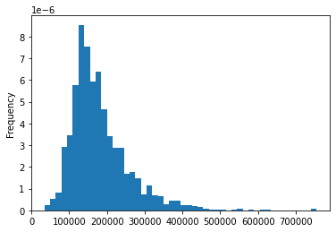
Dataset
We utilize the Ames Housing Dataset which describes a wide range of characteristics of 1,460 homes in Ames, Iowa sold between 2006 and 2010
In total 79 Features(35 numerical and 44 categorical)
1 continuous label the final sale price
Distribution of housing data by price

Slide 4
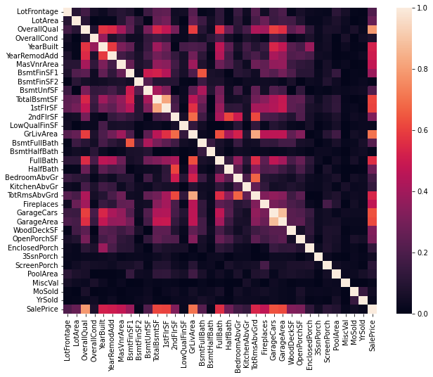
Data Visualization - Numerical Values
Filtered Numerical Values (Correlation > 0.5, Cross Correlation < 0.9)
OverallQual 0.789881
GrLivArea 0.710319
GarageCars 0.639235
GarageArea 0.621918
TotalBsmtSF 0.614420
1stFlrSF 0.606678
FullBath 0.562492
TotRmsAbvGrd 0.536419
YearBuilt 0.522918
YearRemodAdd 0.507138

Slide 5
Model
Standard Scaler for Numerical Features
z = (x - u) / s where u is the mean and s is the standard deviation
Linear Regression
Regularization
LassoCV - L1
10000 iterations
ElasticNetCV - Mixed between L1 and L2
L1 ratios: [0.1, 0.5, 0.7, .91, .95, .97, .99, .995, .999]
10000 iterations
RidgeCV - L2
Alphas [0.1, 1 to 99]

Slide 6
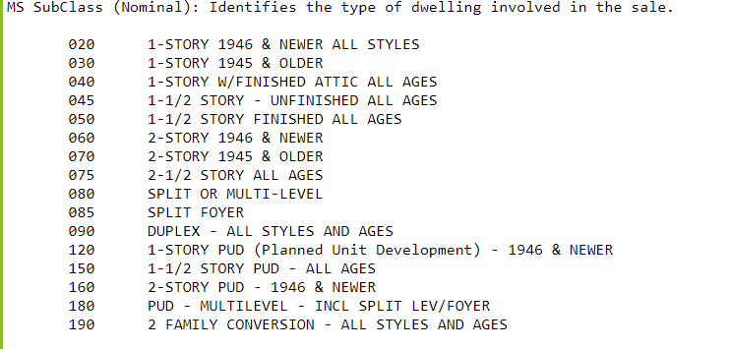
Data Cleaning
First cleaning was converting MSSubClass from a numerical to a categorical as it had vague numbers representing the overall design of the house
For PoolQC, MiscFeature, Alley, Fence, FireplaceQu, GarageQual, BsmtQual all NA’s were replaced with the string ‘None’ because these were categorical features
LotFrontage all nulls were replaced with 0 as it is a numerical feature
We then created dummies on all categorical data
We did not delete any entries during cleaning
The test dataset had additional features with nulls vs the train dataset, but were very small

Slide 7
Test cleaning differences
GarageCars 1
GarageArea 1
KitchenQual 1
Exterior1st 1
SaleType 1
TotalBsmtSF 1
BsmtUnfSF 1
Exterior2nd 1
BsmtFinSF1 1
BsmtFinSF2 1
BsmtFullBath 2
Functional 2
Utilities 2
BsmtHalfBath 2
MSZoning 4

Slide 8
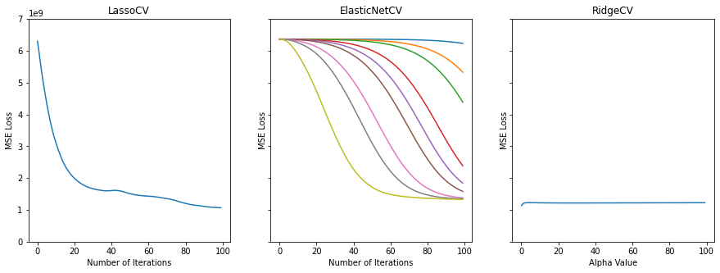
Model Training
Train-test split of 80% train, 20% test
5-fold cross-validation to tune hyperparameters (alpha and L1 ratio)
Regularization acts as a form of embedded feature learning, minimizing the effects of redundant features.
Using other forms of feature selection with these models would be doing feature selection twice, which can lead to overfitting
MSE: Mean Squared Error

Slide 9

Scoring
Took the RMSE of the logs of the predicted and actual values
This makes errors at high sale prices more comparable to errors at low sale prices
Matches the scoring function used on Kaggle
Also measured R^2 less important

Slide 10
Model Scores
LinearRegression
Model rms-log loss: 3.1349100854105236
Model r2 score:-3.560528676193277e+18
LassoCV (142 features left)
Model rms-log loss:0.1478303789866026
Model r2 score:0.7848467175710937
ElasticNetCV (93 features left)
Model rms-log loss:0.14693145682911965
Model r2 score:0.8112441750101802
RidgeCV (66 features left)
Model rms-log loss:0.1758915086491916
Model r2 score:0.7414461492936231

Slide 11
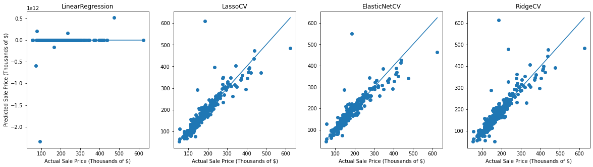
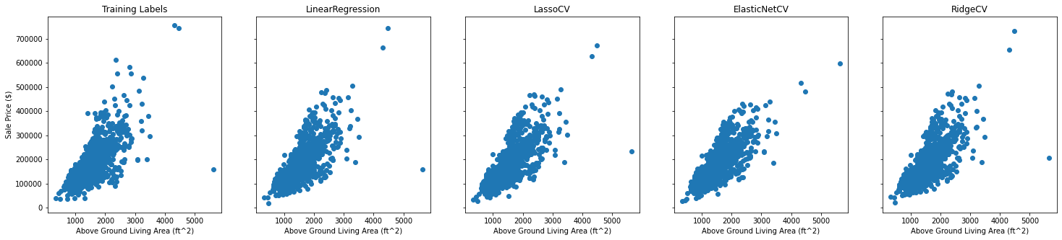
Model Results
Notes:
The graphs on the first row show the comparison between actuals vs predicted values for our 4 models on the train set. We wanted to use linear regression as a comparison against the other 3 models, but we found that when predicting values in our train set it would often predict a couple of values that were up to 10 orders of magnitude higher than the actual sale price. We think that this is because without regularization, the model coefficients can grow to be these massive numbers in an effort to fit to the train set.
You can see on the second row where we compare the predictions for the train set along the feature Above Ground Living Area that Linear Regression fits the training data in a similar way to RidgeCV. All three types of regularization do a similar job predicting values for the train set, but in the future with Linear Regularization we are going to stick with ElasticNetCV because it can behave like Lasso, Ridge, or anything in between to get the best score.
Couple of outlier predictions on LinearRegression massively deflate it’s performance metrics
Could be because without regularization the coefficients can grow to be massive numbers
Linear Regression otherwise seems to make predictions similar to RidgeCV
Up top: One feature with the model predictions for the training set
Below: Comparison between predicted and actual sale price for each model in the test set

Slide 12
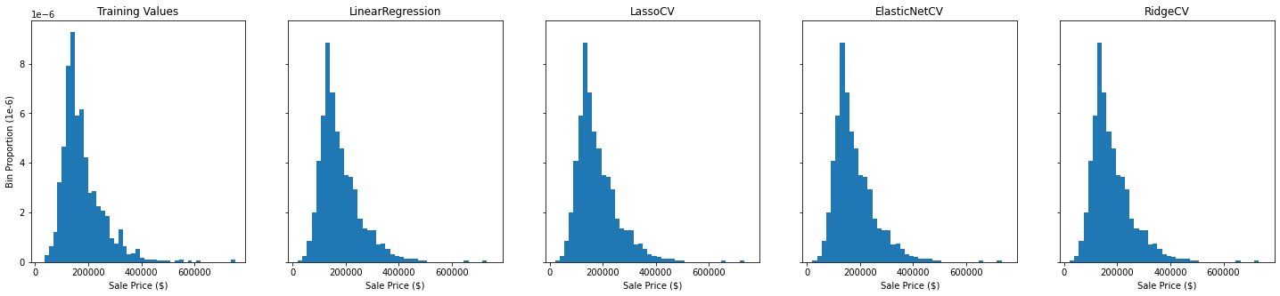
Label Histograms

Slide 13
Challenges
Linear Regression model predicted massive outliers that made comparison by scoring metrics hard.
Data set had null values we had to choose whether to clean or convert to a None category.
Some features had non-linear relationships with the sale price. We think other methods we try in the future will better account for these relationships.
Notes:
Our major 3 challenges are the linear regression outliers mentioned earlier, handling null values in our dataset, and better modeling the nonlinear relationships in our dataset. For the linear regression outliers we used graphs to investigate the results beyond just two scoring metrics, for our dataset as Luc mentioned earlier some null values clearly indicated none or non-applicable while others we had to exercise our best judgement, and for the non linear relationships we are going to use more advanced feature embedding and prediction models.

Slide 14
Conclusion
Timeline:
Design Revised Model
11/8/2022
Revised Hyperparameter Search
11/11/2022
Revised Model Training and Assessment
11/15/2022
Submit to Kaggle
11/17/2022
Write Report and Presentation
11/29/2022
Things left to do:
Code to create predictions for Kaggle submission
Test with more advanced regression models
Feedforward Neural Networks
Dimensionality Reduction
PCA
Autoencoders
Embedding Methods
Spectral Embedding

